Slide 1

GRAPH THEORY AND ITS APPLICATIONS
Dr. Arti Arya
Department of Computer Science & Engineering

Slide 2
GRAPH THEORY AND ITS APPLICATIONS
Graph Coloring
Dr. Arti Arya
Department of Computer Science & Engineering

Slide 3

Graph Theory and its Applications Acknowledgement
The slides are prepared by Dr. Surabhi Narayan and a lot of content is added by Dr. Arti Arya. The sources of the information other than text book is mentioned wherever used.

Slide 4
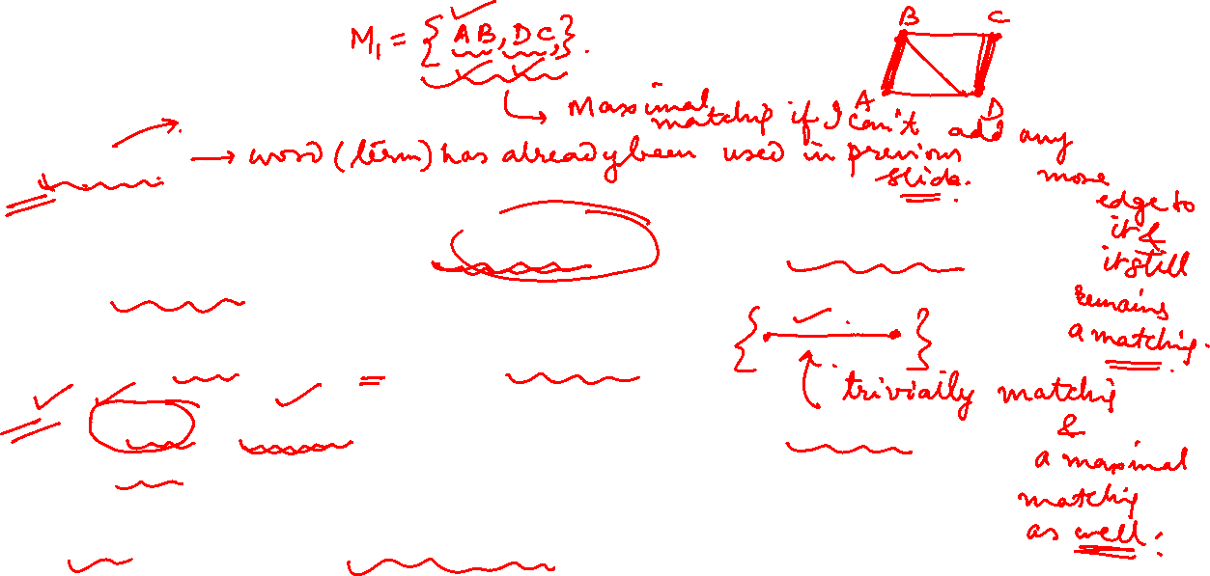
Graph Theory and its Applications Matchings
Matchings
A matching in a graph is a subset of edges in which no two edges adjacent to each other.( adjacent edges mean no common vertex between the edges)
A single edge in a graph is trivially a matching.
A maximal matching set is a matching set to which no edge in the graph can be added and it still remains a matching.
Any single edge is a maximal matching.

Slide 5
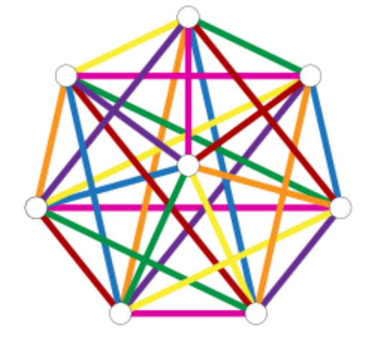
Graph Theory and its Applications
Matchings
A Graph may have many different maximal matchings.
Maximal matchings may be of different sizes.
Maximal matching with largest number of edges is called largest maximal matching.
Edge coloring means no edges of the same color adjacent to each other.

Slide 6

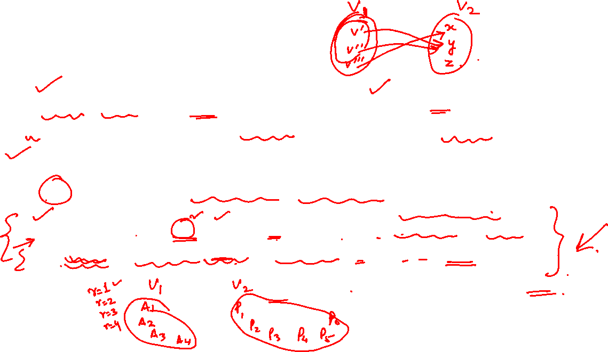
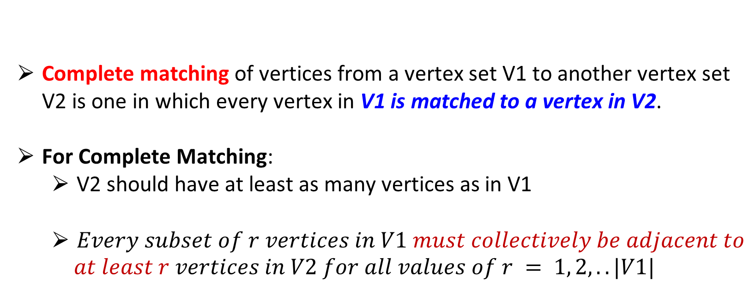
Graph Theory and its Applications
Matchings
Complete matching of vertices from a vertex set V1 to another vertex set V2 is one in which every vertex in V1 is matched to a vertex in V2.
For Complete Matching:
V2 should have at least as many vertices as in V1
$Every subset of r vertices in V1 must collectively be adjacent to$
$$at least r vertices in V2 for all values of r = 1, 2, ..|V1|$$

Slide 7
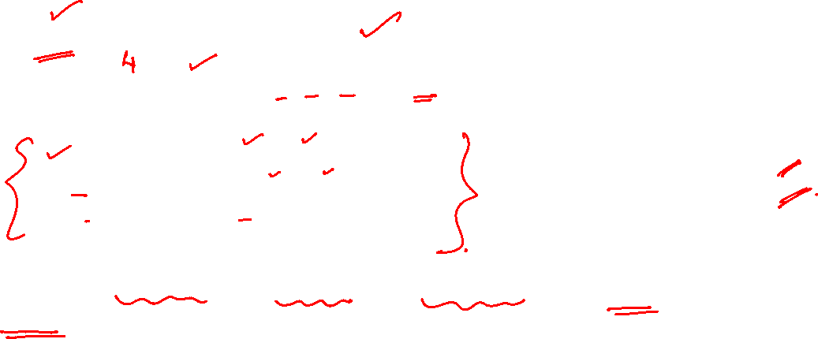
Graph Theory and its Applications
Matchings
An Example
Suppose that four applicants A1, A2, A3 and A4 are available to fill 6 vacant positions P1, P2, P3, P4, P5, and P6
A1 is qualified for P2 or P5
A2 is qualified for P2 or P5
A3 is qualified for P1, P2, P3, P4 or P6
A4 is qualified for P2 or P5
Is it possible to hire all the applicants and assign each a position for which applicant is suitable?
This is a matching Problem
or assignment problem

Slide 8
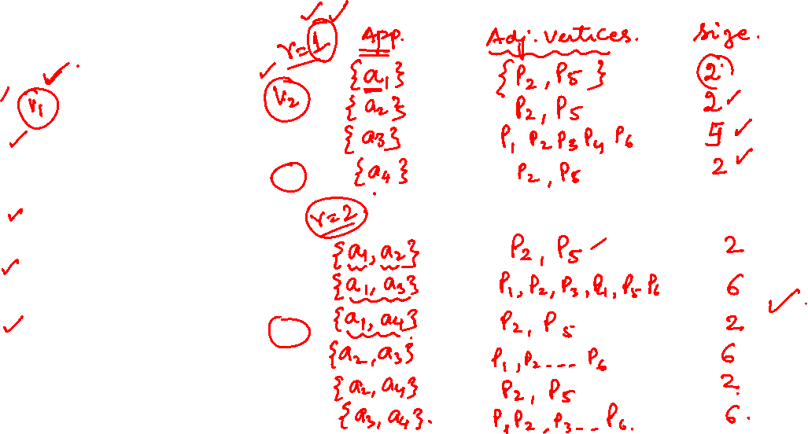
Graph Theory and its Applications Matchings
Matchings
a1
p1
p2
a2
p3
a3
p4
a4
p5
p6

Slide 9
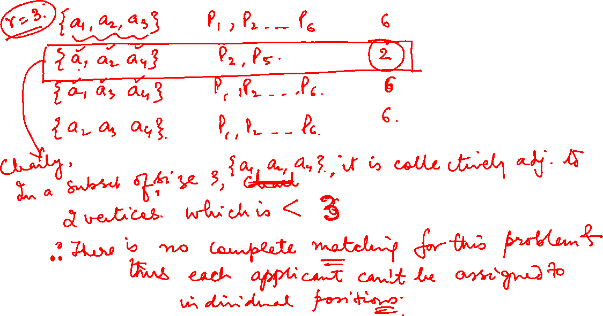
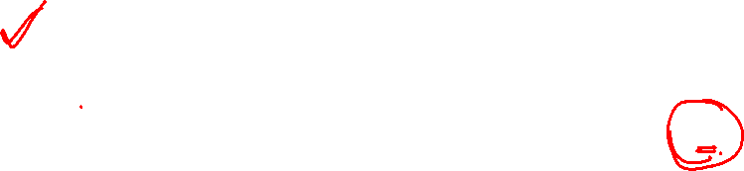

Slide 10
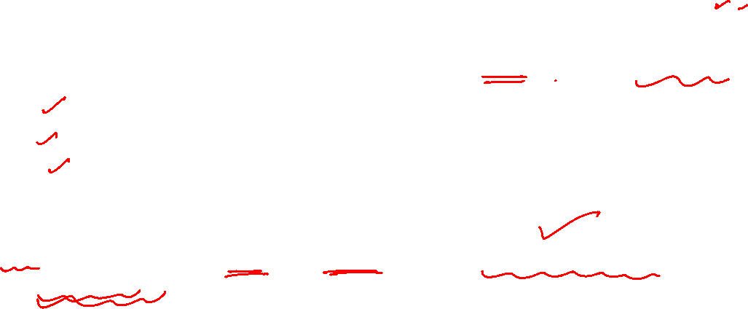
Graph Theory and its Applications Matchings
Five politicians S1, S2, S3, S4, and S5 are members of three committees C1, C2 and C3. One member from each committee is to be represented in a super committee.
S1 is a member of C1 and C2 S2 is a member of C1
S3 is a member of C2 and C3 S4 is a member of C2 and C3 S5 is a member of C3
Is it possible to form the super committee with one distinct representative from each committee?

Slide 11
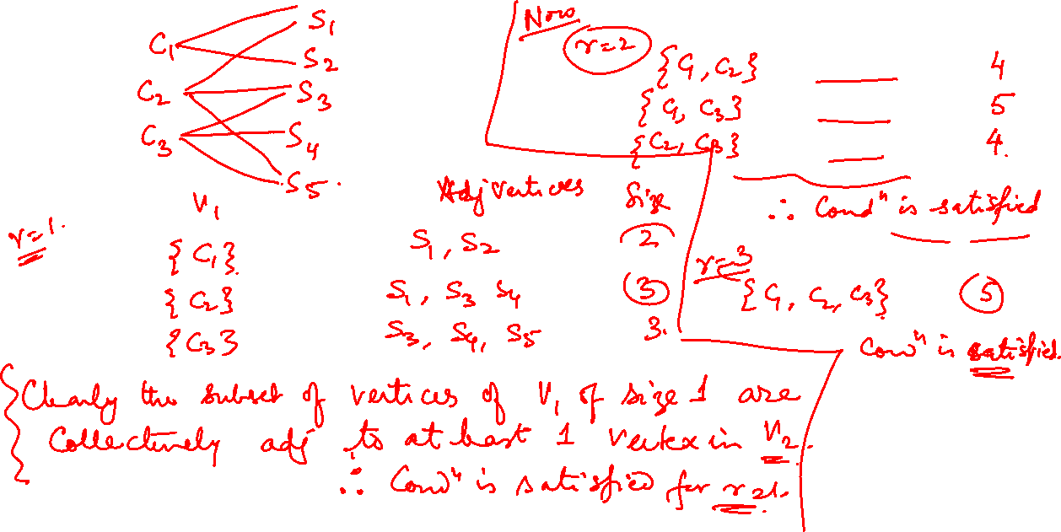
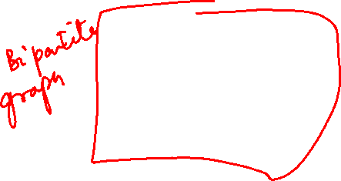

Slide 12
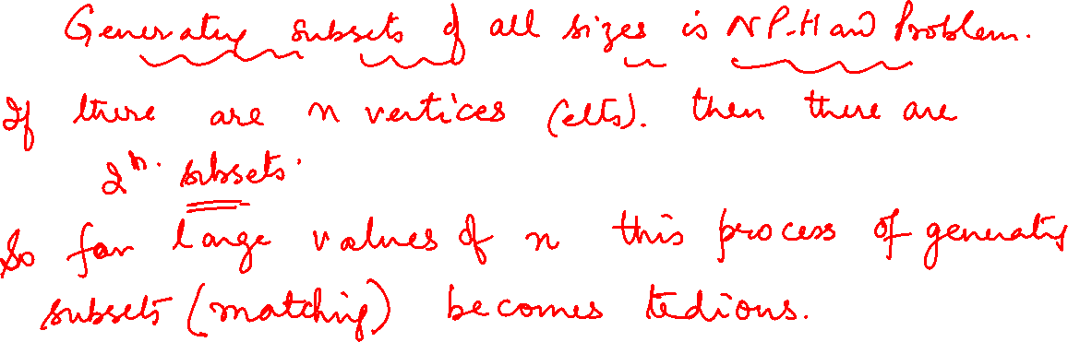

Slide 13

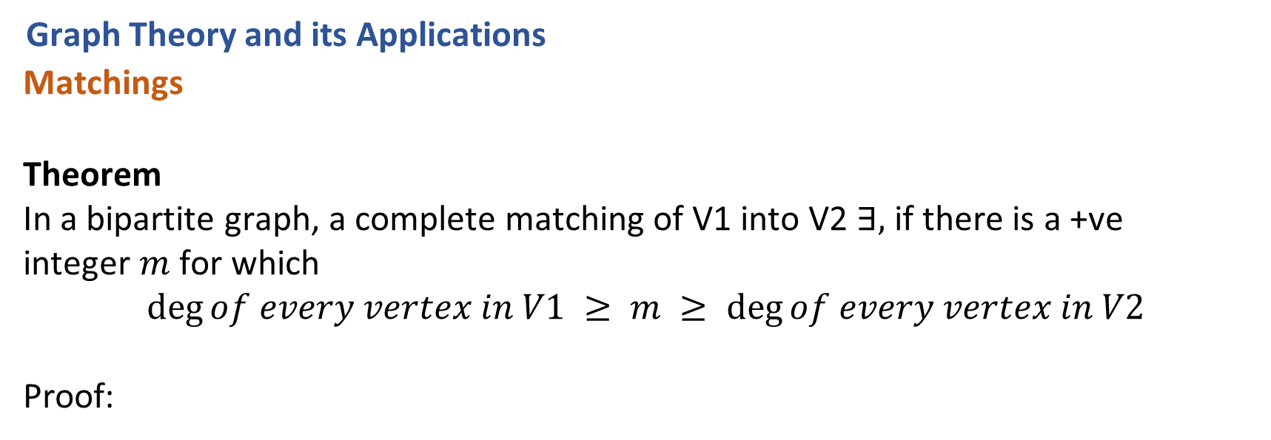
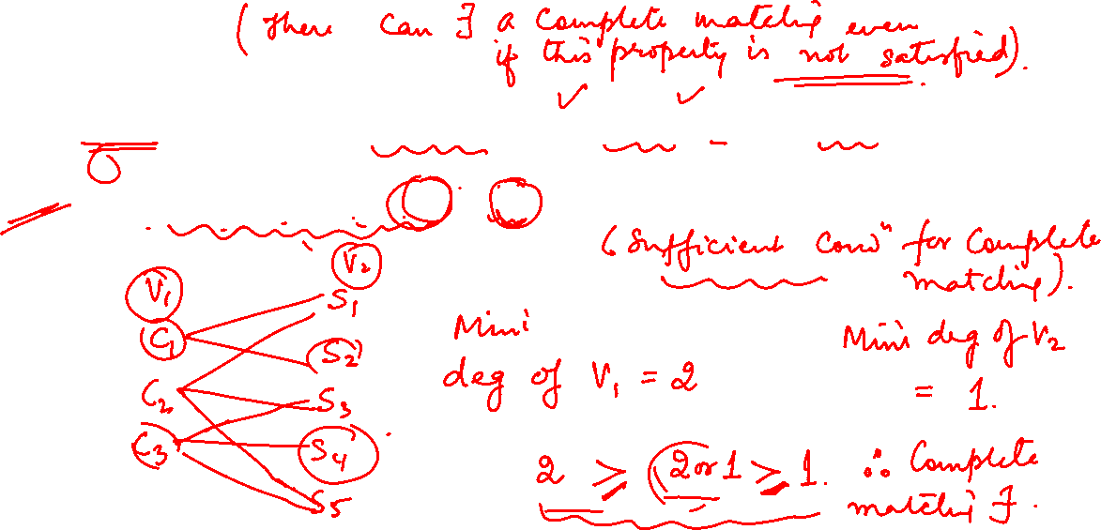
Graph Theory and its Applications Matchings
Theorem
In a bipartite graph, a complete matching of V1 into V2 $∃,$ if there is a +ve
integer $m$ for which
$$deg⁡of every vertex in V1 ≥ m ≥ deg⁡of every vertex in V2$$
Proof:

Slide 14
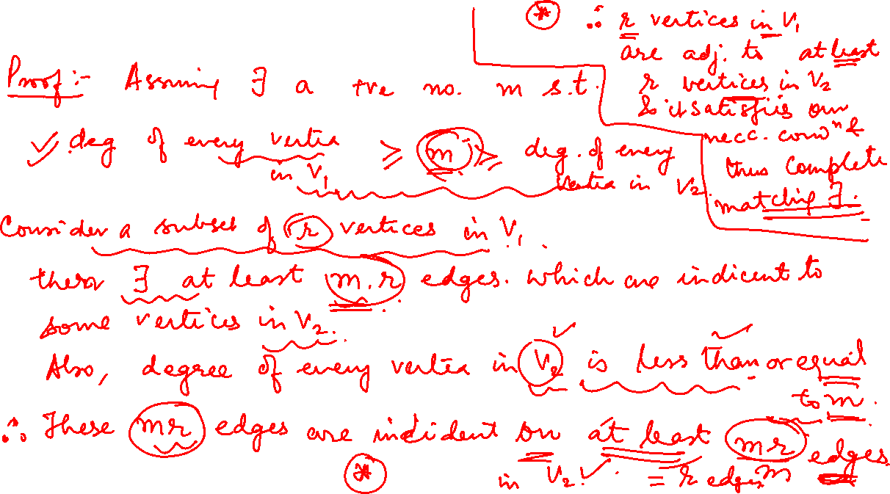

Slide 15
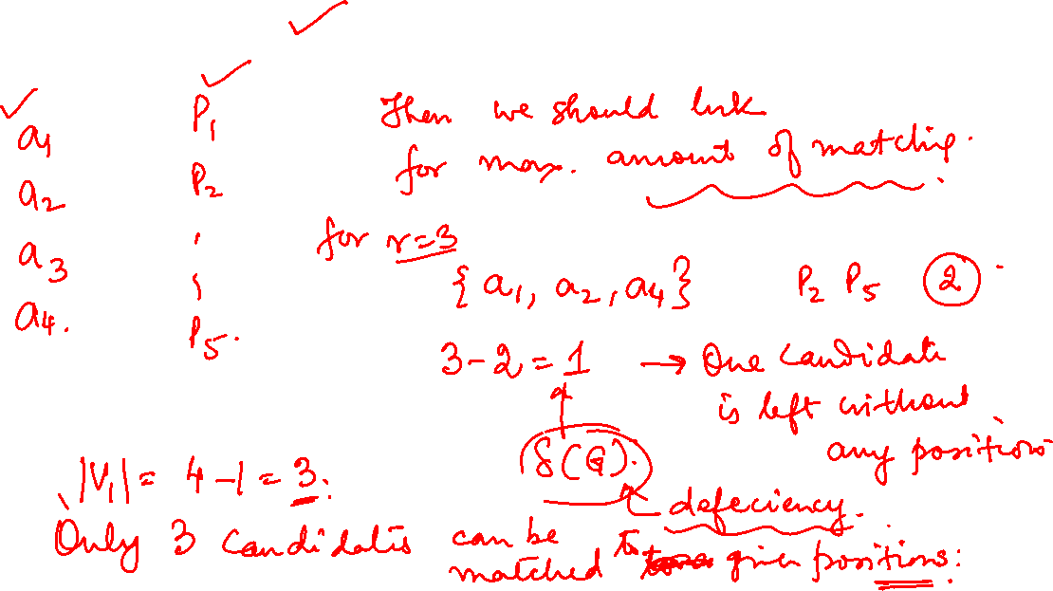
If Complete matching doesn’t Exist

Slide 16
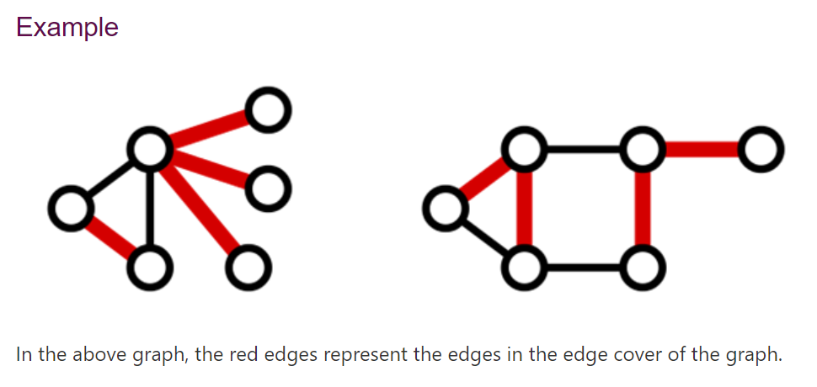
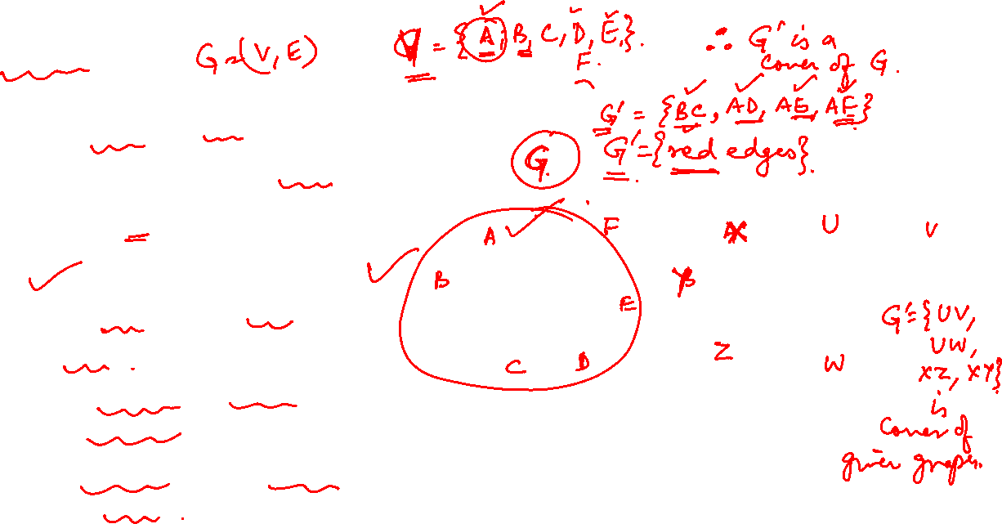
Graph Theory and its Applications Coverings
In a graph G, a set G’ of edges is said to cover G if every vertex in G is incident on at least one edge in G’.
A graph G is trivially its own covering.
A spanning tree in a connected graph is a covering.
A Hamiltonian cycle in a graph G is a covering.

Slide 17
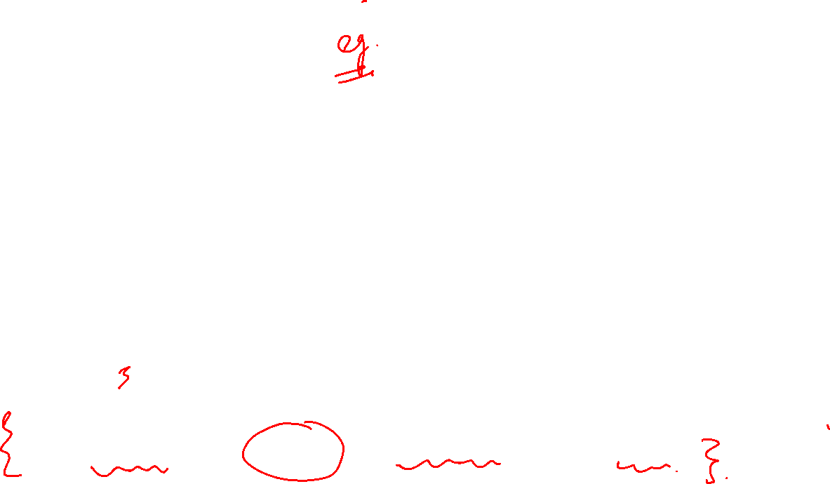
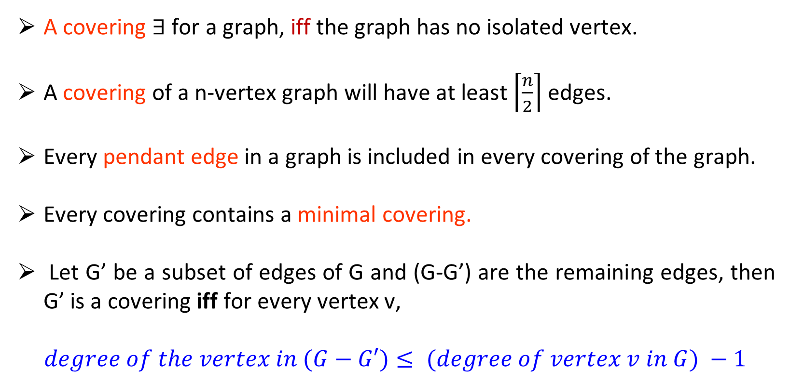
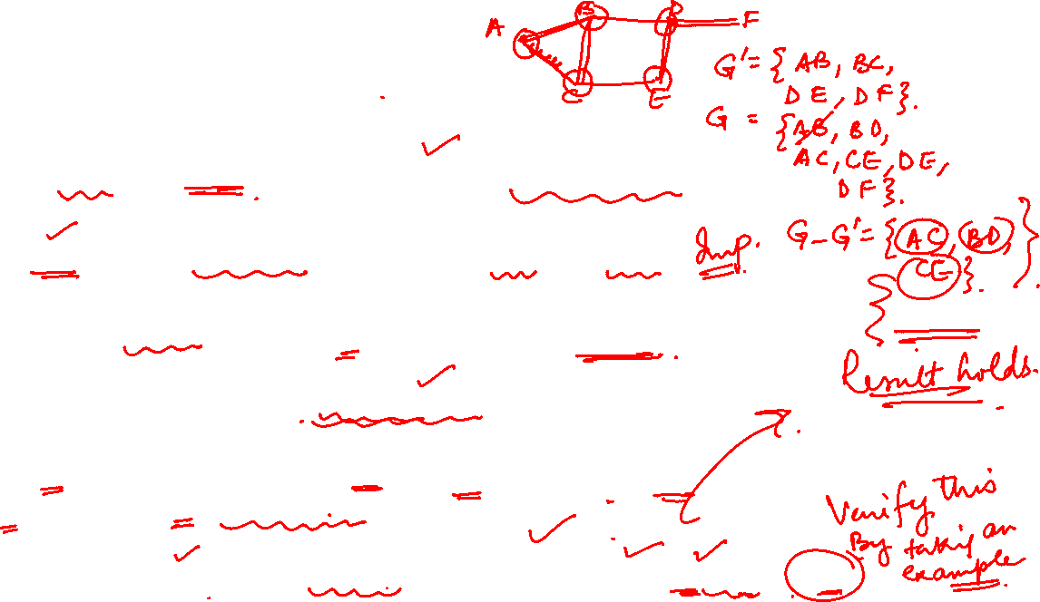
Graph Theory and its Applications Coverings
A covering $∃$ for a graph, iff the graph has no isolated vertex.
A covering of a n-vertex graph will have at least $\left\lceil \frac{n}{2}\right\rceil$ edges.
Every pendant edge in a graph is included in every covering of the graph.
Every covering contains a minimal covering.
Let G’ be a subset of edges of G and (G-G’) are the remaining edges, then G’ is a covering iff for every vertex v,
$$degree of the vertex in (G−G′)≤ (degree of vertex v in G) −1$$

Slide 18
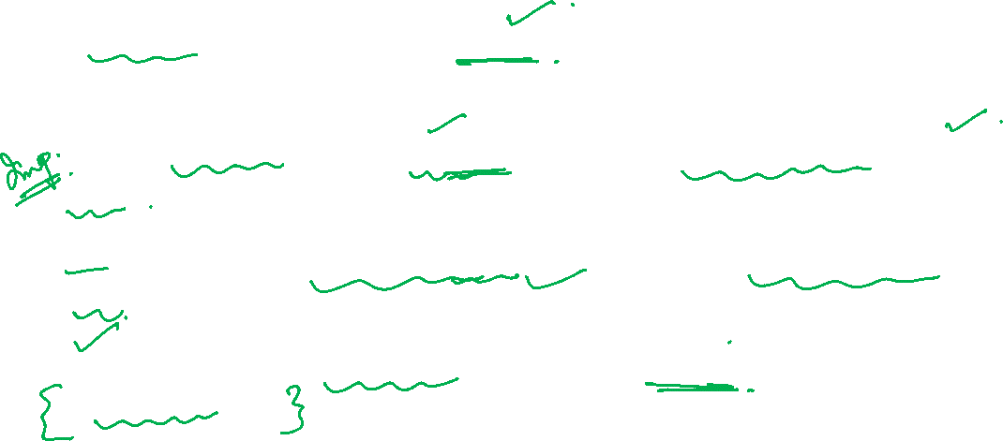
Graph Theory and its Applications Coverings
No minimal covering can contain a circuit, for we can always remove an edge from a circuit without leaving any vertices uncovered.
A minimal covering of an n-vertex graph can contain no more then n-1 edges.
A graph can have many minimal coverings, and they may be of different sizes.
The # of edges in a minimal covering of the smallest size is called the covering number.

Slide 19
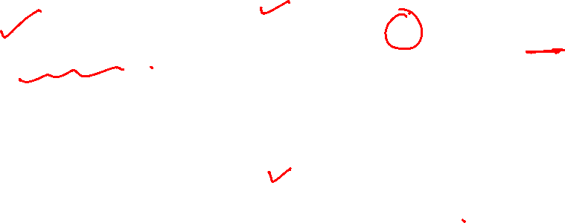
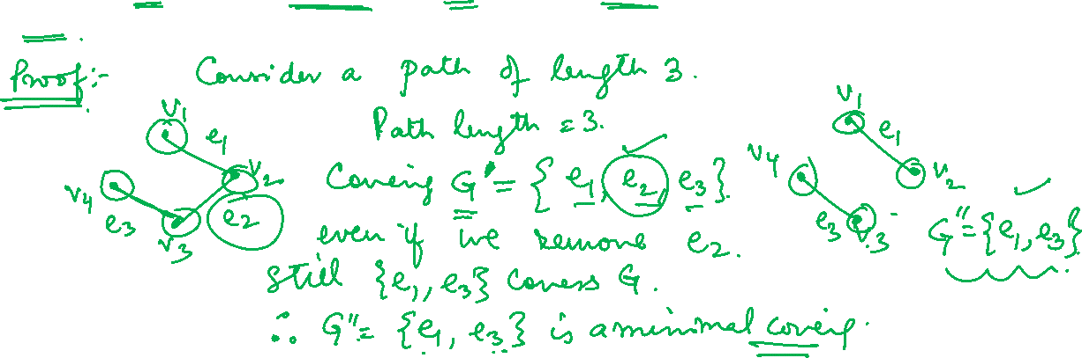
Graph Theory and its Applications Matchings
Theorem
A covering G’ of a graph is minimal iff G’ contains no paths of length
3 or more.

Slide 20
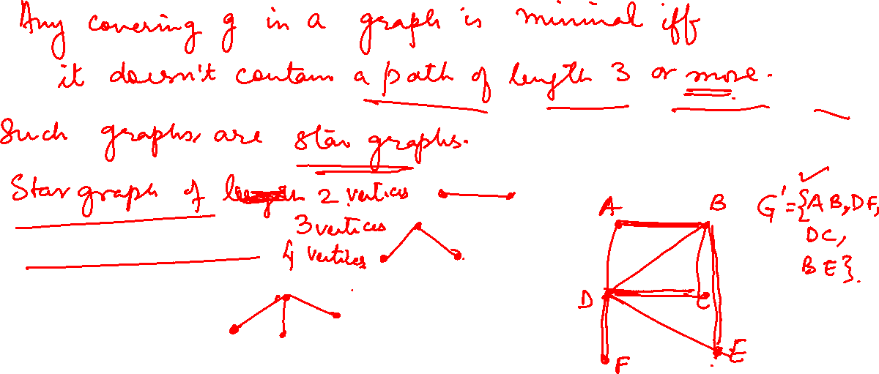

Slide 21
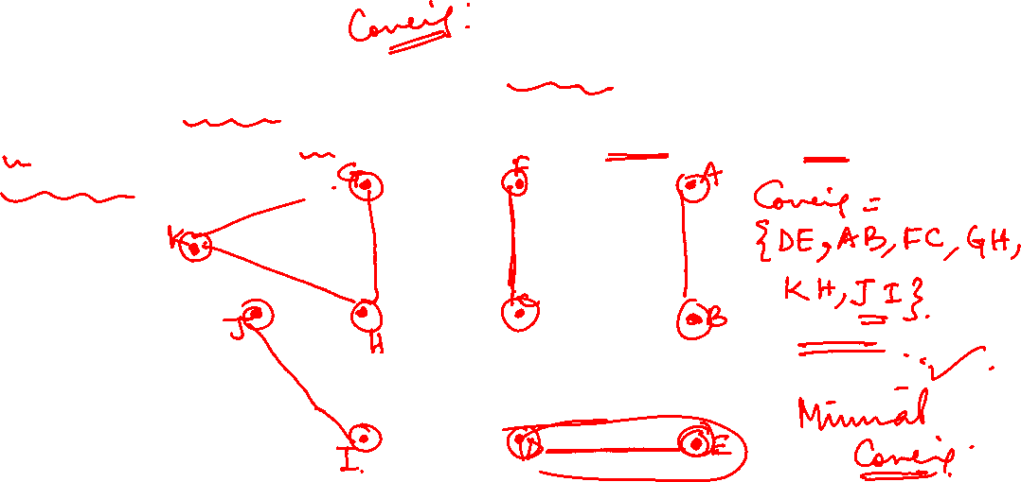
Graph Theory and its Applications Matchings
Applications of Coverings
1. Given graph represents the street map of part of a city. Each of the vertices is a potential trouble spot and must be kept under the surveillance of a patrol car. How will you assign a minimum number of patrol cars to keep every vertex covered.

Slide 22
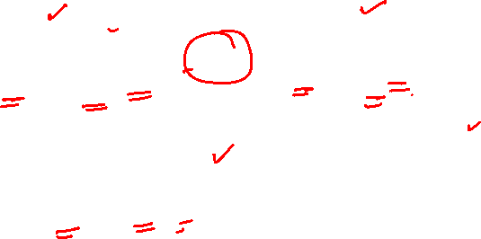
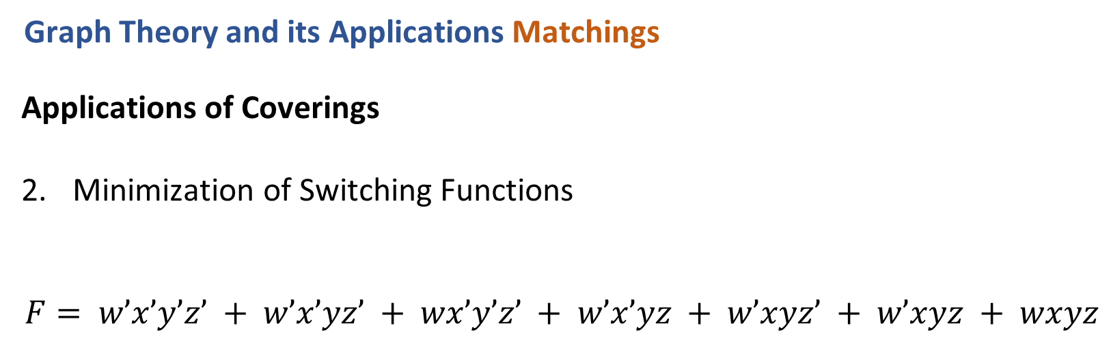
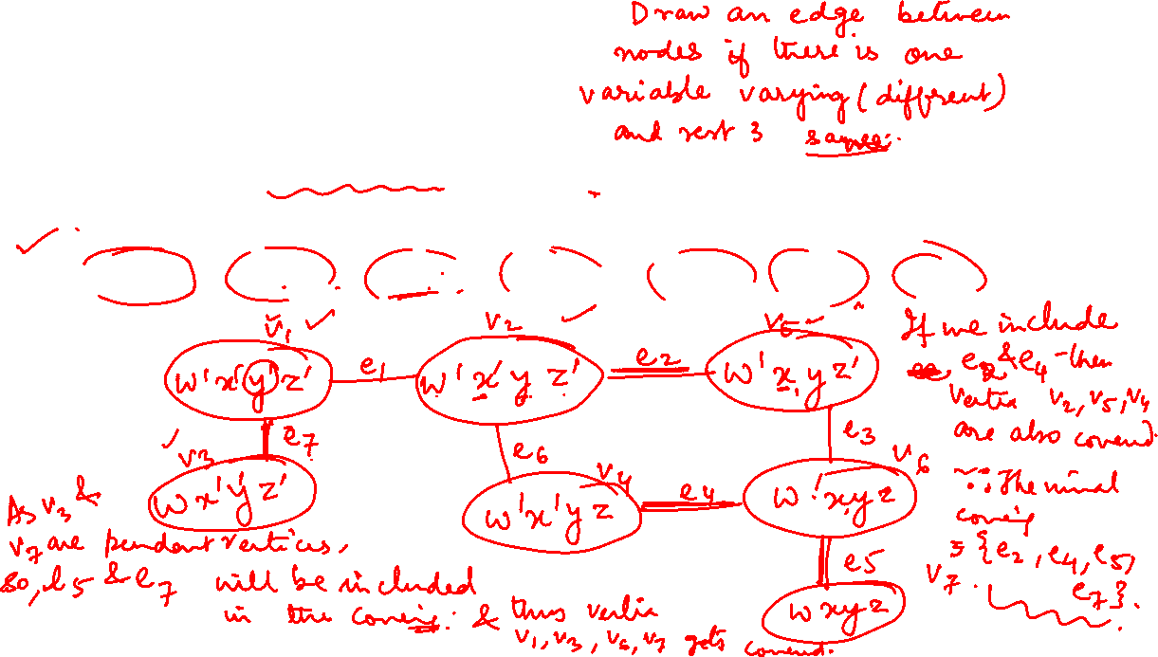
Graph Theory and its Applications Matchings
Applications of Coverings
Minimization of Switching Functions
$$F= w’x’y’z’ + w’x’yz’ + wx’y’z’ + w’x’yz + w’xyz’ + w’xyz + wxyz$$

Slide 23
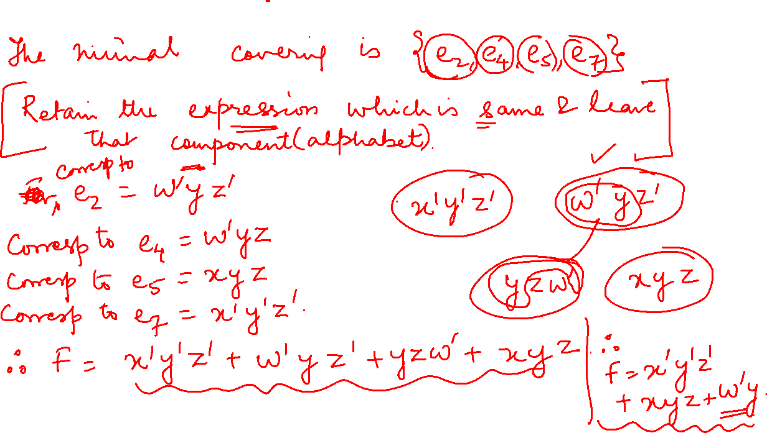

Slide 24
THANK YOU
Dr. Arti Arya
Department of Computer Science &Engineering
artiarya@pes.edu

